Slide 1



以電光非週期性晶格極化反轉鈮酸鋰晶體應用於雙波長雷射系統之腔內布拉格繞射元件之設計與研究
Aperiodic Poled Lithium Niobate Electro-optic Bragg Deflector as an Efficient Laser Q-switch in a Dual-wavelength Solid-State Laser
NILP
國立中央大學 光電科學與工程學系 碩士班
非線性積體雷射光學實驗室
學生：曾冠翔
指導教授：陳彥宏 博士
National Central University Department of Optical and Photonics
Nonlinear Integrated Laser Photonics Laboratory
NILP

Slide 2
Outline
Introduction
Working principles
Device design
Device fabrication
Experimental results and discussion
Conclusion
Outlook
National Central University Department of Optical and Photonics
Nonlinear Integrated Laser Photonics Laboratory
NILP

Slide 3
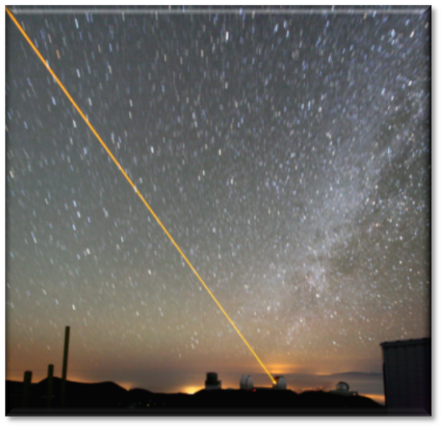
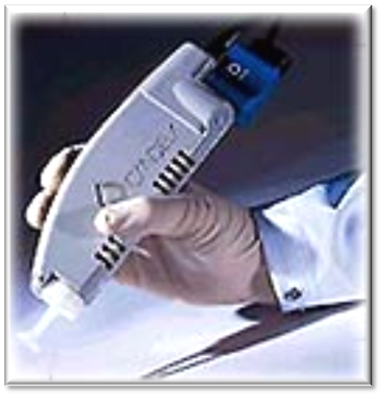
Introduction
Applications of coherent yellow/orange sources
National Central University Department of Optical and Photonics
Nonlinear Integrated Laser Photonics Laboratory
NILP

Slide 4
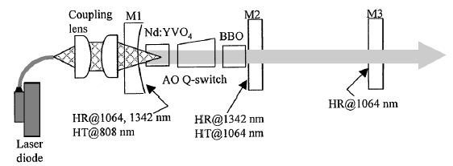
Introduction
Use of AO deflectors as an active Q-switch device.
397,Vol. 27, No. 6 / OPTICS LETTERS
National Central University Department of Optical and Photonics
Nonlinear Integrated Laser Photonics Laboratory
NILP

Slide 5
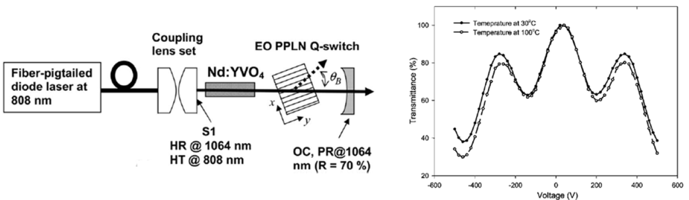
Introduction
Vol. 32, No. 5 / OPTICS LETTERS
National Central University Department of Optical and Photonics
Nonlinear Integrated Laser Photonics Laboratory
NILP

Slide 6
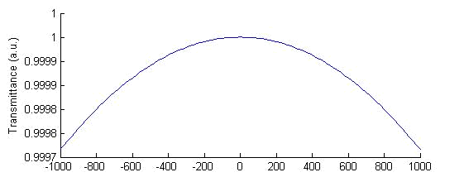
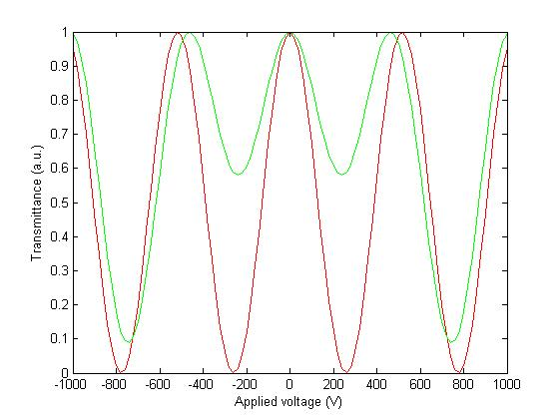
Introduction
1064 nm
1065 nm
1342 nm
National Central University Department of Optical and Photonics
Nonlinear Integrated Laser Photonics Laboratory
NILP

Slide 7
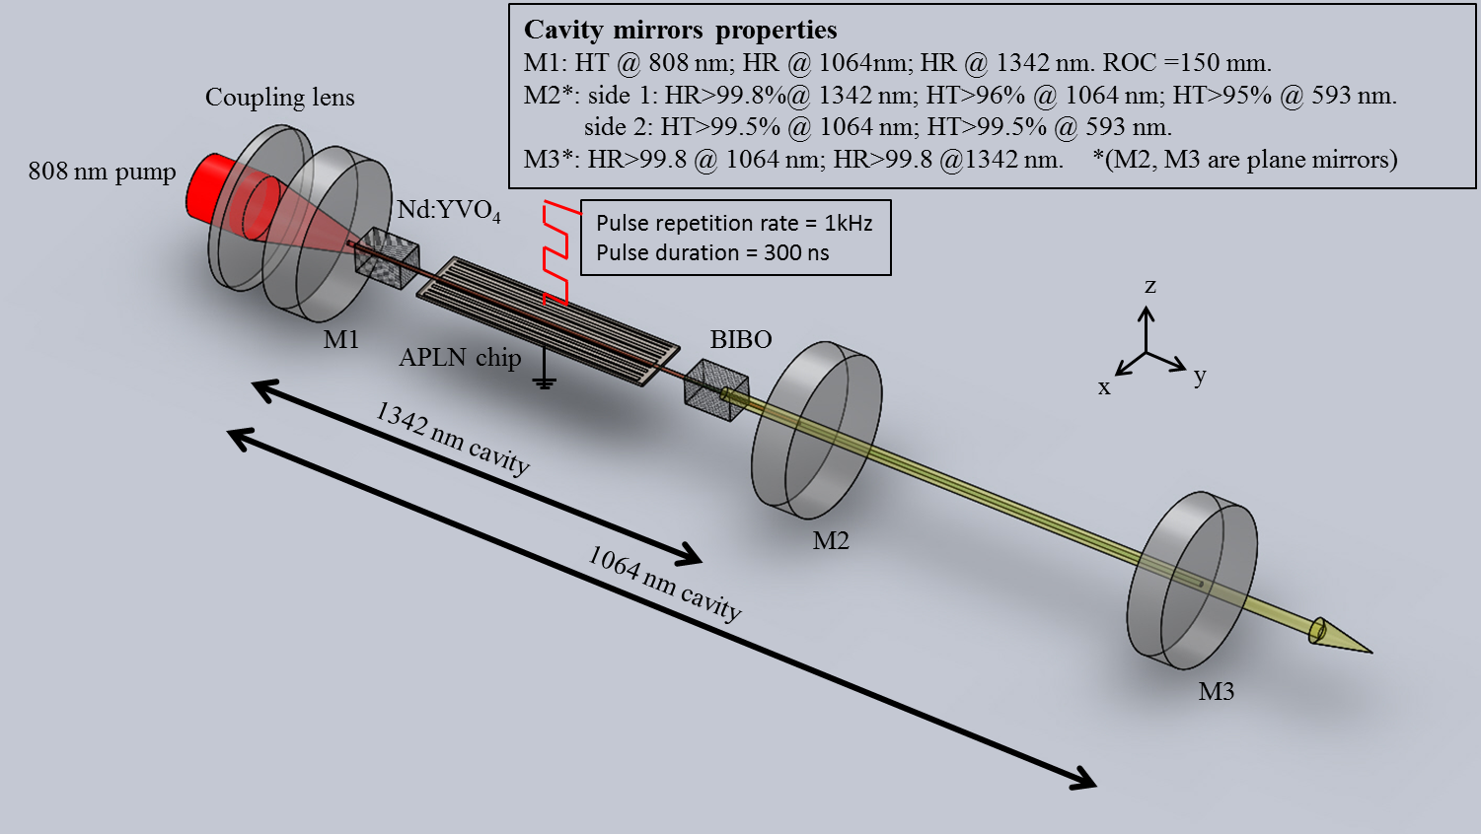
In this work
 | APLN | Nd:YVO₄ | BIBO
Crystal length | 40 mm | 7 mm | 8 mm
Aperture | 0.5x10 mm² | 3x3 mm² | 3x3 mm²
Else | Z-cut | 0.5-at. % Nd³⁺ doping
National Central University Department of Optical and Photonics
Nonlinear Integrated Laser Photonics Laboratory
NILP

Slide 8
WORKING PRINCIPLES
NILP
National Central University Department of Optical and Photonics
Nonlinear Integrated Laser Photonics Laboratory
NILP

Slide 9
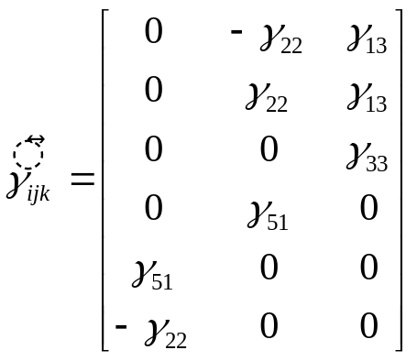
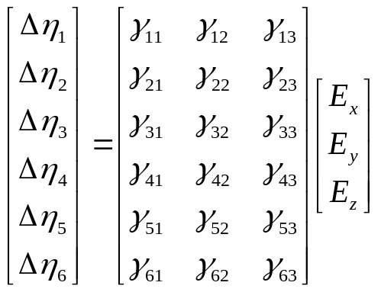
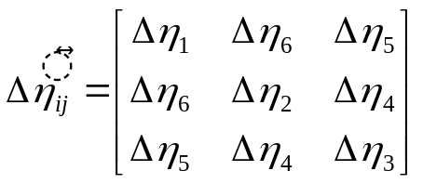
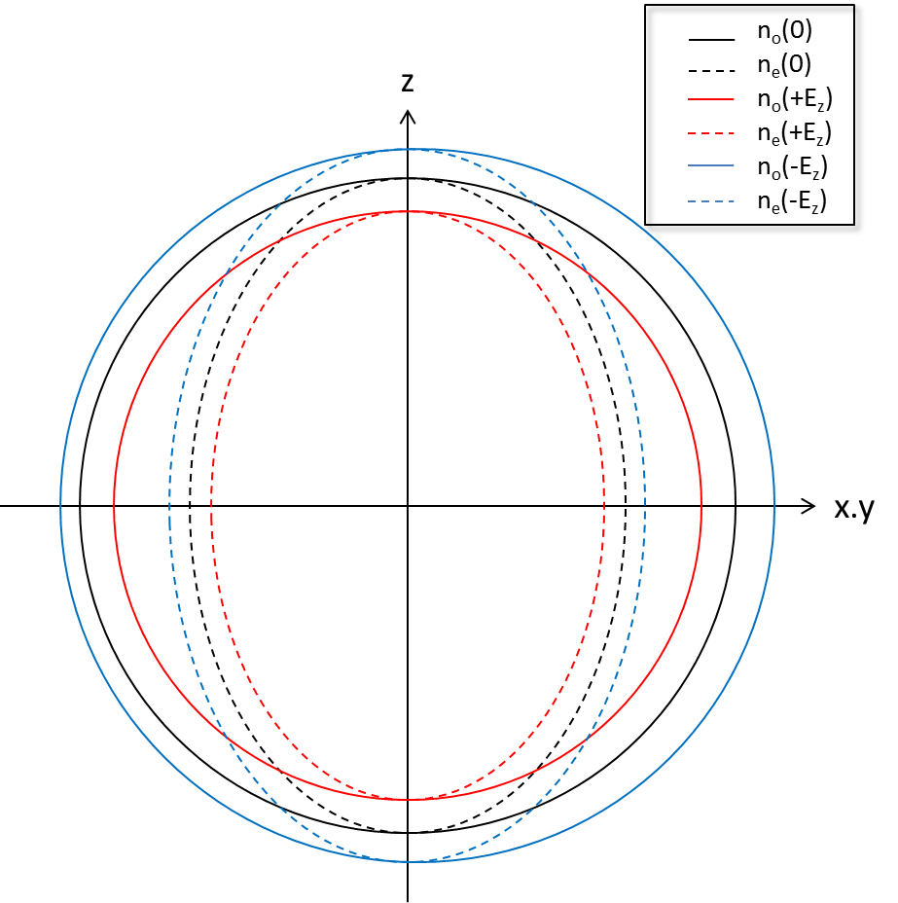
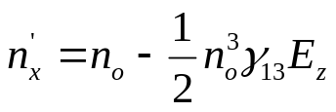
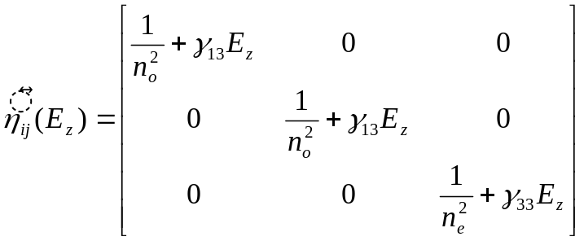
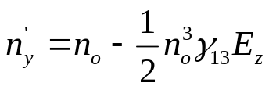
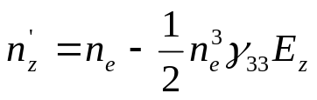


Electro-optics effect (Pockels effect)
In LiNbO₃
，
National Central University Department of Optical and Photonics
Nonlinear Integrated Laser Photonics Laboratory
NILP

Slide 10
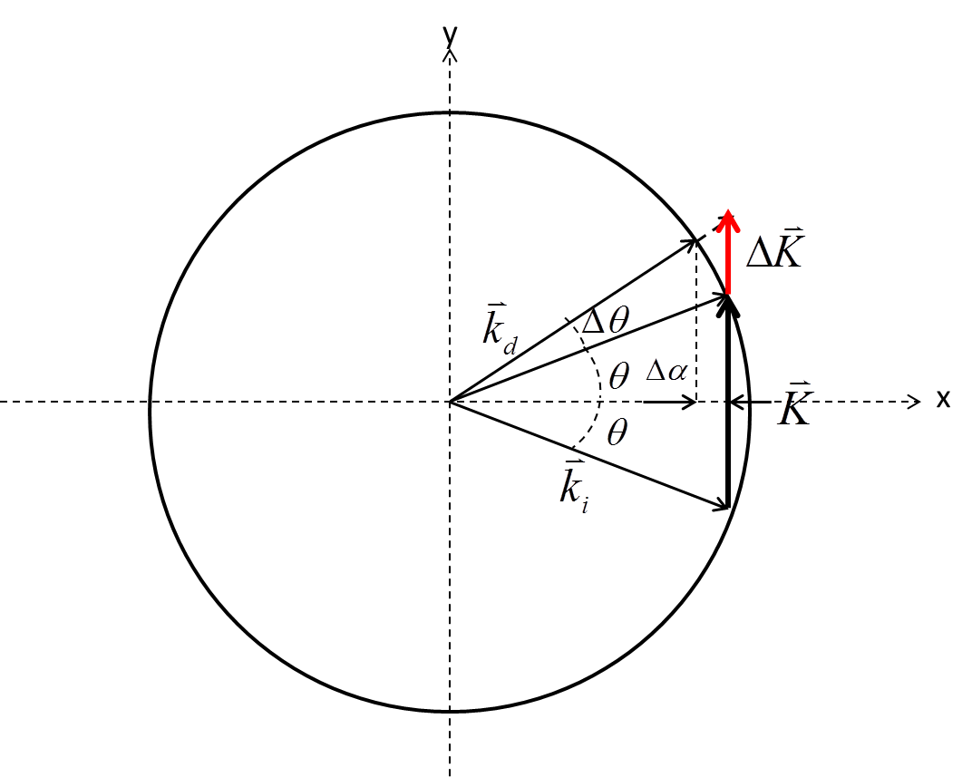

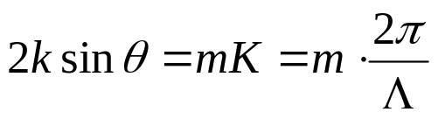

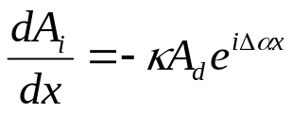
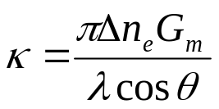
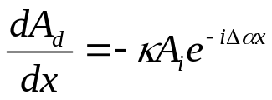

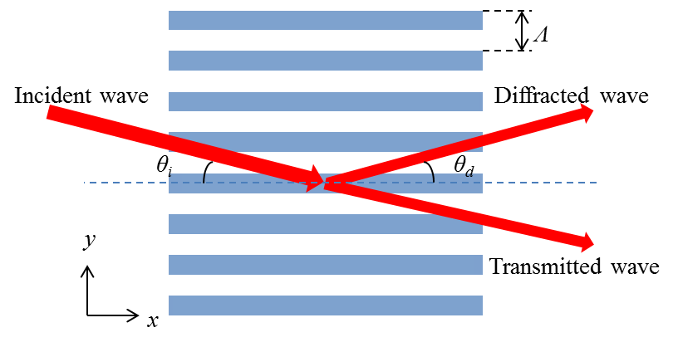
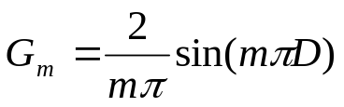
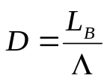
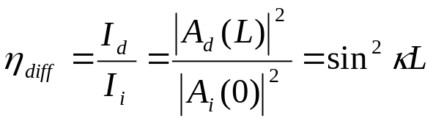
EO Bragg diffraction
；
m : Order of structure
m = 1, 3,…
National Central University Department of Optical and Photonics
Nonlinear Integrated Laser Photonics Laboratory
NILP

Slide 11
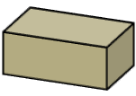
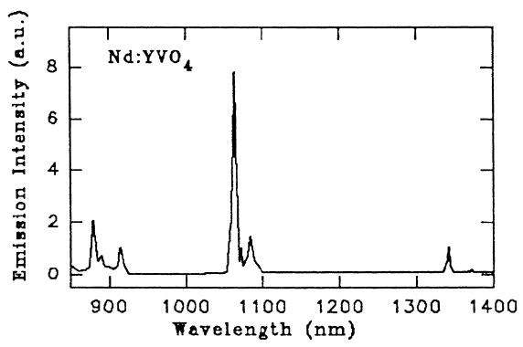
Q-switching
W_{p}
Pump band
t
γ
⁴F_{3/2}
1342 nm
t
808 nm
q(t)
1064 nm
⁴F_{13/2}
⁴F_{11/2}
t
N(t)
Ground state
N_{i}
N_{f}
t
z
y
Nd:YVO₄
3 mm × 3 mm laser aperture and 7 mm length, a-cut, 0.5-at. % Nd³⁺ doping concentration.
x
National Central University Department of Optical and Photonics
Nonlinear Integrated Laser Photonics Laboratory
NILP

Slide 12
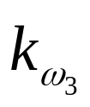


BPM SFG in BIBO crystal
BIBO(BiB₃O₆)
  Negative uniaxial crystal
  Type I phase-matching
  Phase matching angle:
  θ=3.3º,φ=0ºd_{eff} : 3.0+/-0.1 pm/V
ω₂
ω₃
ω₁
1342 nm
BIBO
593 nm
1064 nm
C-axis of BIBO
National Central University Department of Optical and Photonics
Nonlinear Integrated Laser Photonics Laboratory
NILP

Slide 13
DEVICE DESIGN
NILP
National Central University Department of Optical and Photonics
Nonlinear Integrated Laser Photonics Laboratory
NILP

Slide 14



Dual wavelength modulation
1064 nm
1065 nm
1342 nm
1342 nm
1064 nm
θ_{d}
θ_{i}
National Central University Department of Optical and Photonics
Nonlinear Integrated Laser Photonics Laboratory
NILP

Slide 15
Aperiodic domain structure design
Use of aperiodic optical superlattice (AOS) technique and simulated annealing (SA) method
L = 40 mm, is the crystal length.
l = 300 μm, is the beam diameter we set.
d = 500 μm is the thickness of substrate
Δx = 4 μm, is unit block length.
z
L
↑
↑
↓
↓
↑
↑
↑
↓
↑
↑
↓
↓
↓
↑
↓
↑
↓
↓
↑
↑
↓
↓
↑
↑
x
d
y
Δx
l
National Central University Department of Optical and Photonics
Nonlinear Integrated Laser Photonics Laboratory
NILP

Slide 16
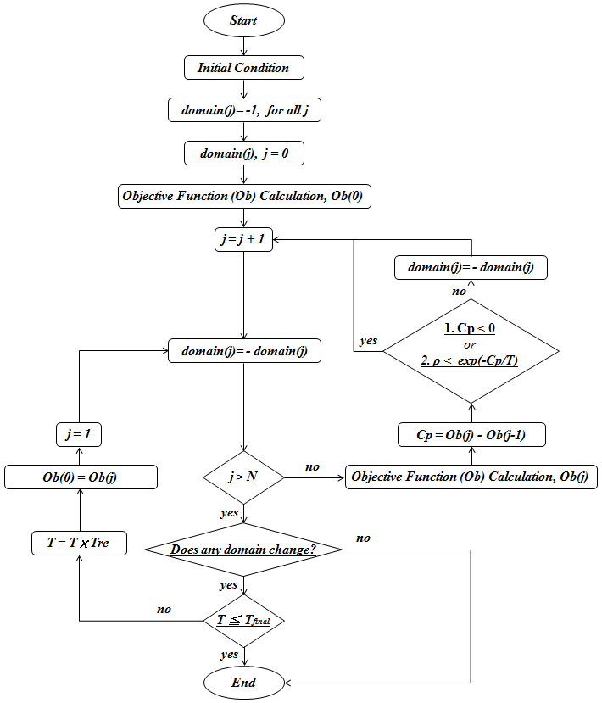
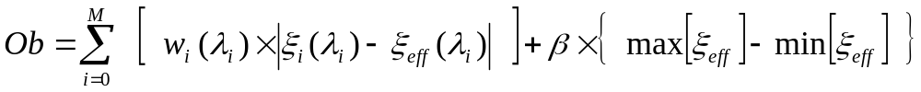
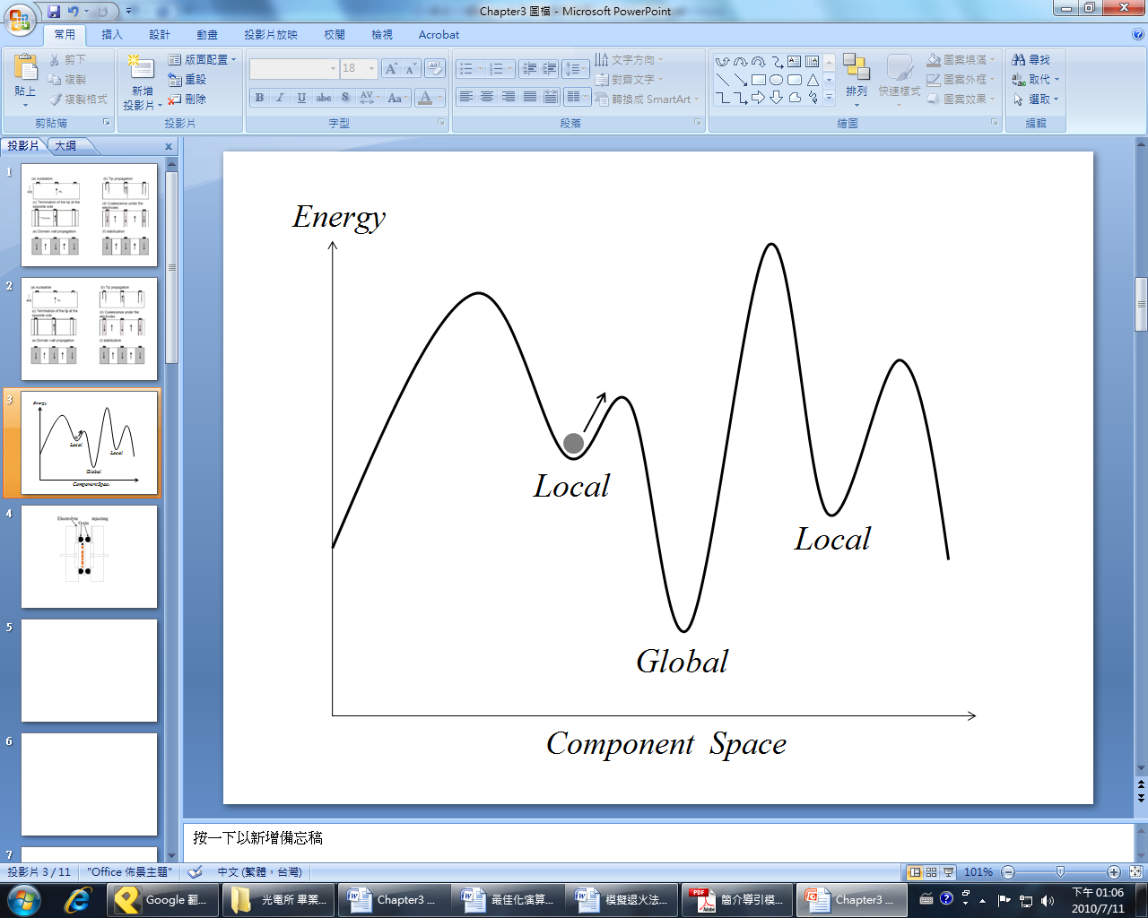
SA algorithm
↓
↑
↓
↑
↓
↓
↓
↑
↓
↑
↓
↓
↓
↓
↓
↓
↓
↑
……
……
↓
↑
↓
↑
中央大學光電所 呂學璁碩士論文
National Central University Department of Optical and Photonics
Nonlinear Integrated Laser Photonics Laboratory
NILP

Slide 17
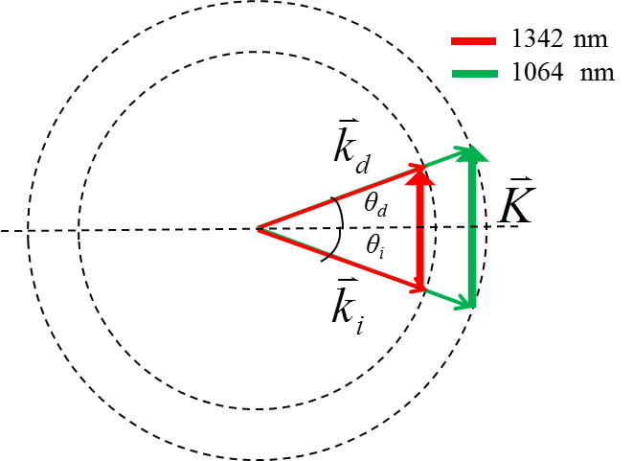


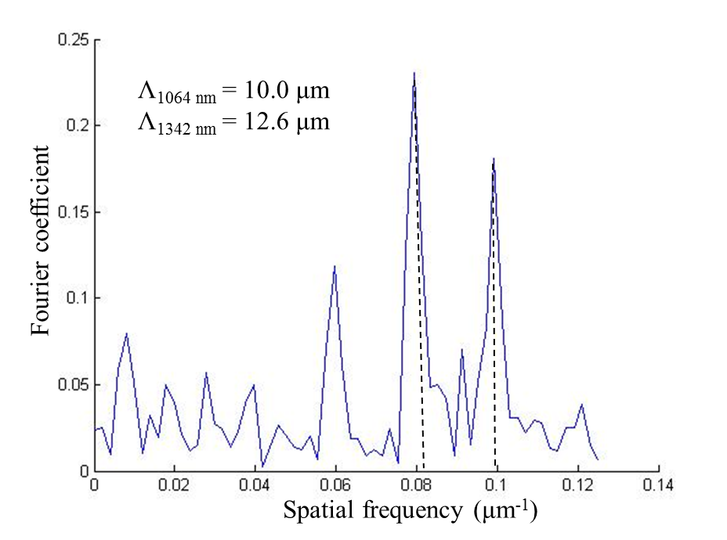
Calculation results
Design parameters
  Beam diameter : 300 μm
  Unit block length : 4 μm
  Chip length : 40 mm
  Incident angle : 1.471°
  Applied voltage : 200 V
η_{1064 nm} = 93.23%
η_{1342 nm} = 92.25%
National Central University Department of Optical and Photonics
Nonlinear Integrated Laser Photonics Laboratory
NILP

Slide 18
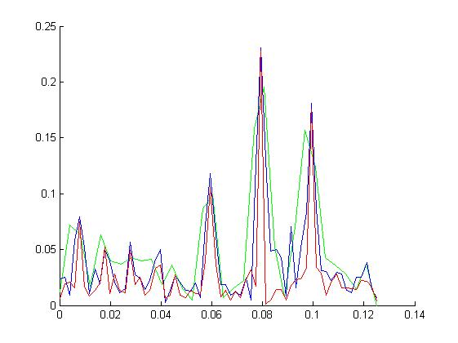
Beam size effect
200 um
300 um
500 um
Fourier coefficient
Spatial frequency (μm⁻¹)
National Central University Department of Optical and Photonics
Nonlinear Integrated Laser Photonics Laboratory
NILP

Slide 19
DEVICE FABRICATION
NILP
National Central University Department of Optical and Photonics
Nonlinear Integrated Laser Photonics Laboratory
NILP

Slide 20
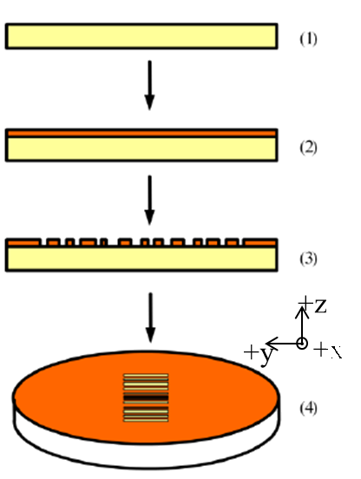
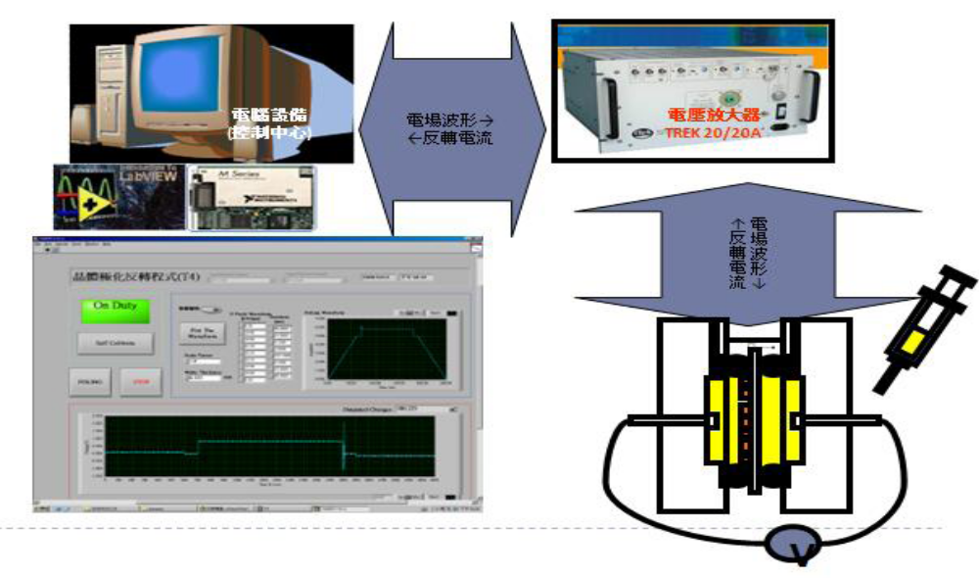
Domain inversion
National Central University Department of Optical and Photonics
Nonlinear Integrated Laser Photonics Laboratory
NILP

Slide 21
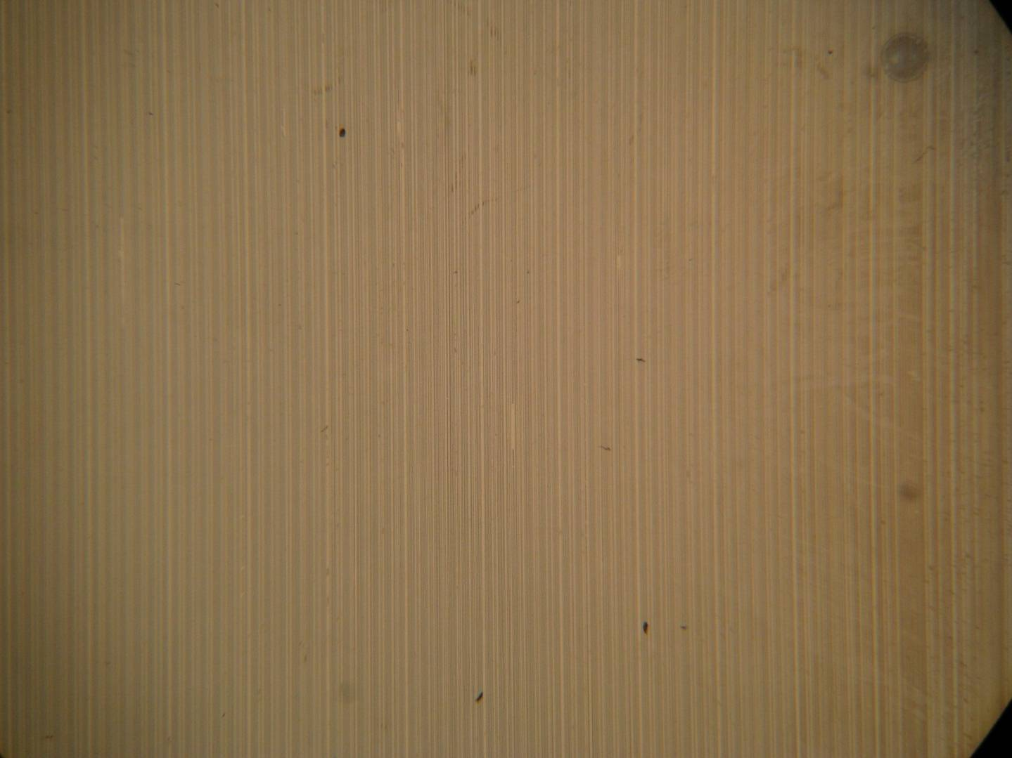
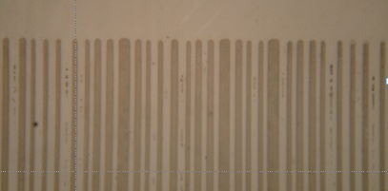
Domain revealing (by HF)
y
Minimum domain width ~ 4 μm
x
National Central University Department of Optical and Photonics
Nonlinear Integrated Laser Photonics Laboratory
NILP

Slide 22
EXPERIMENTAL RESULTS and DISCUSSION
NILP
National Central University Department of Optical and Photonics
Nonlinear Integrated Laser Photonics Laboratory
NILP

Slide 23
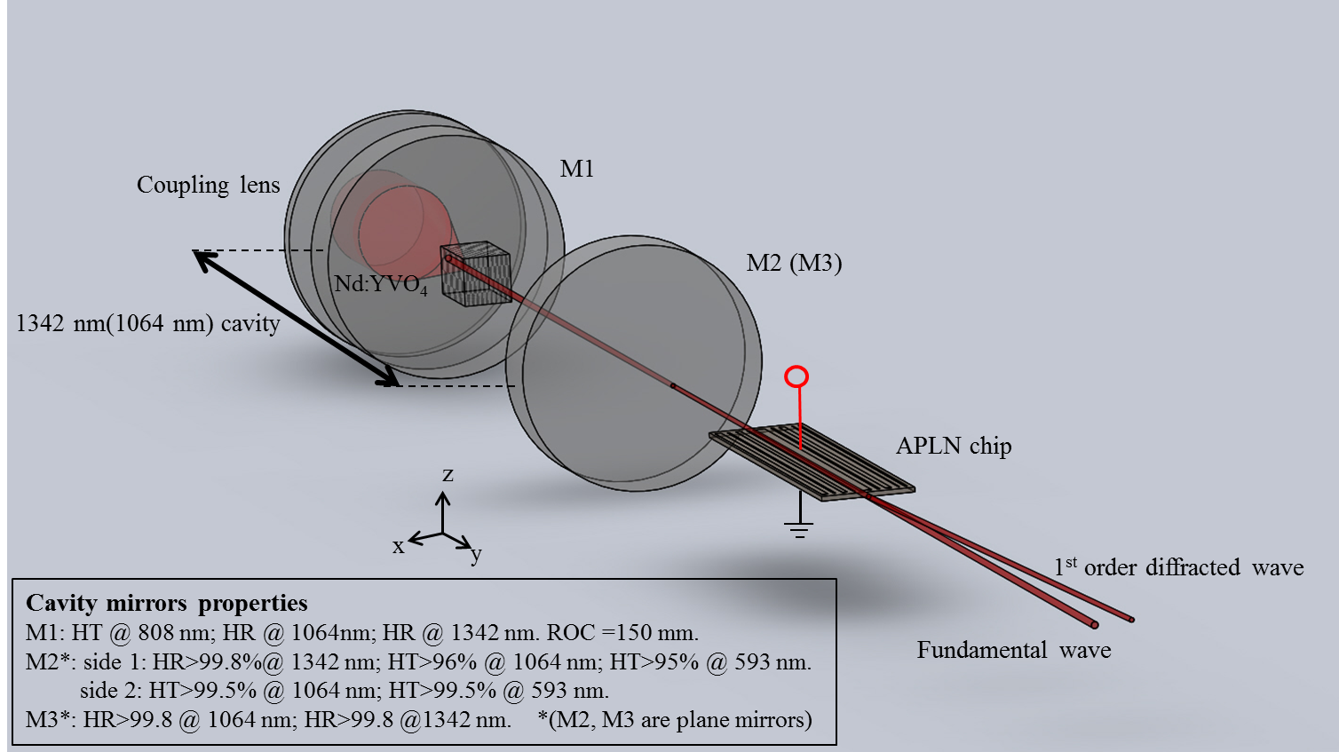
Diffraction efficiency measurements
 | 1064 nm | 1342 nm
Cavity length | 83 mm | 153 mm
Beam radius at output of APLN | 296 um | 264 um
Distance from M2(M3)to APLN | 70 mm | 22 mm
Setup
National Central University Department of Optical and Photonics
Nonlinear Integrated Laser Photonics Laboratory
NILP

Slide 24
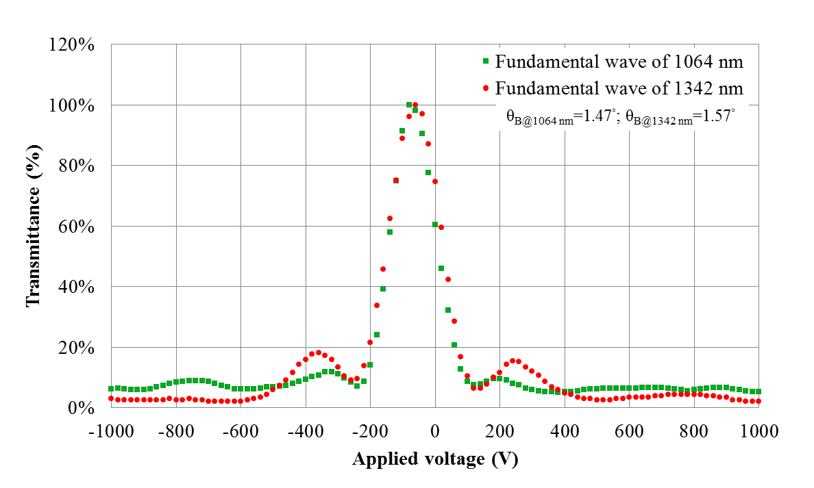
Diffraction efficiency measurements
National Central University Department of Optical and Photonics
Nonlinear Integrated Laser Photonics Laboratory
NILP

Slide 25
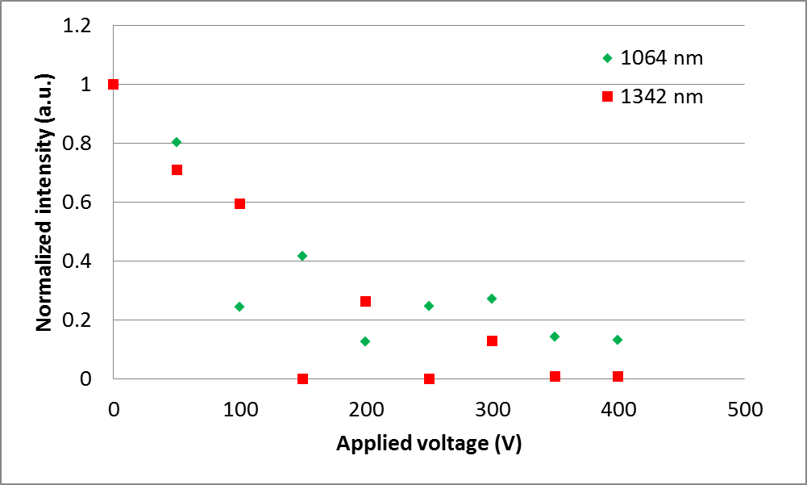
Dual-wavelength laser diffraction efficiency
National Central University Department of Optical and Photonics
Nonlinear Integrated Laser Photonics Laboratory
NILP

Slide 26
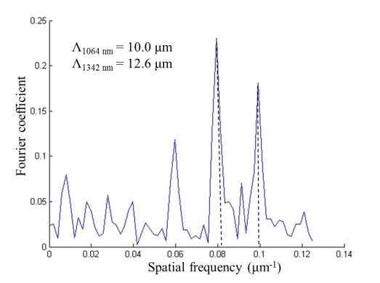
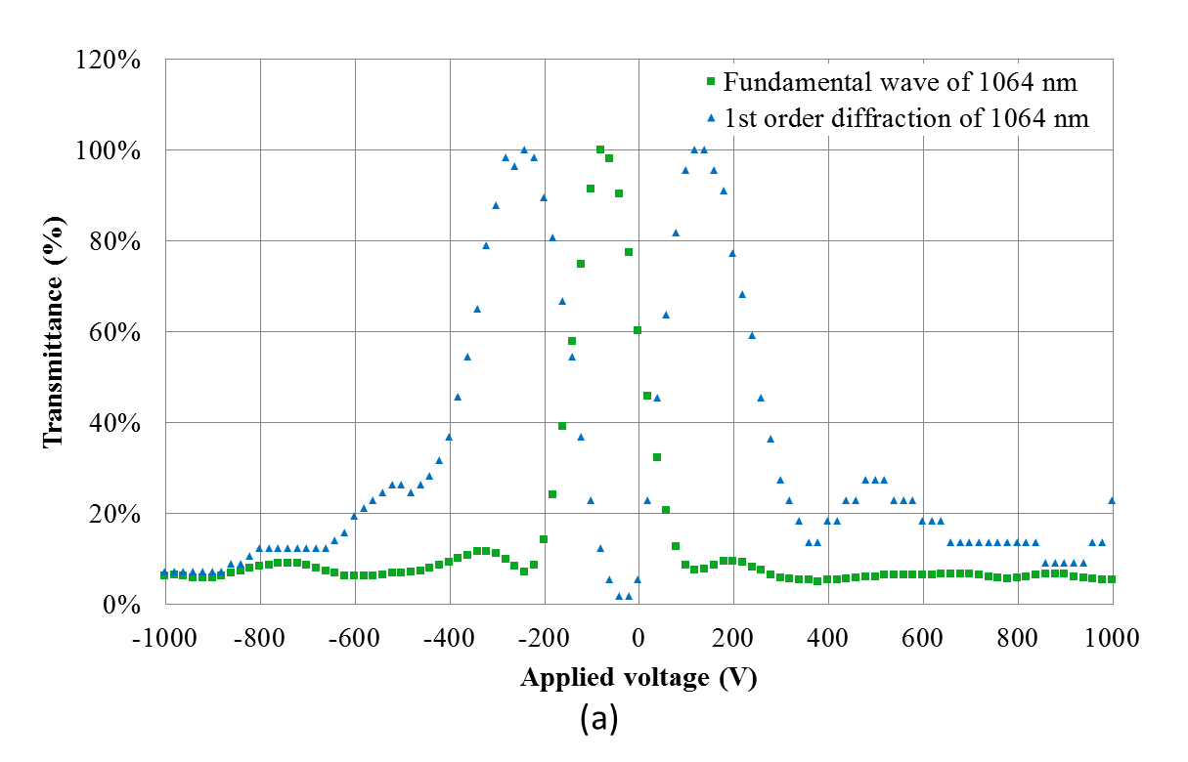
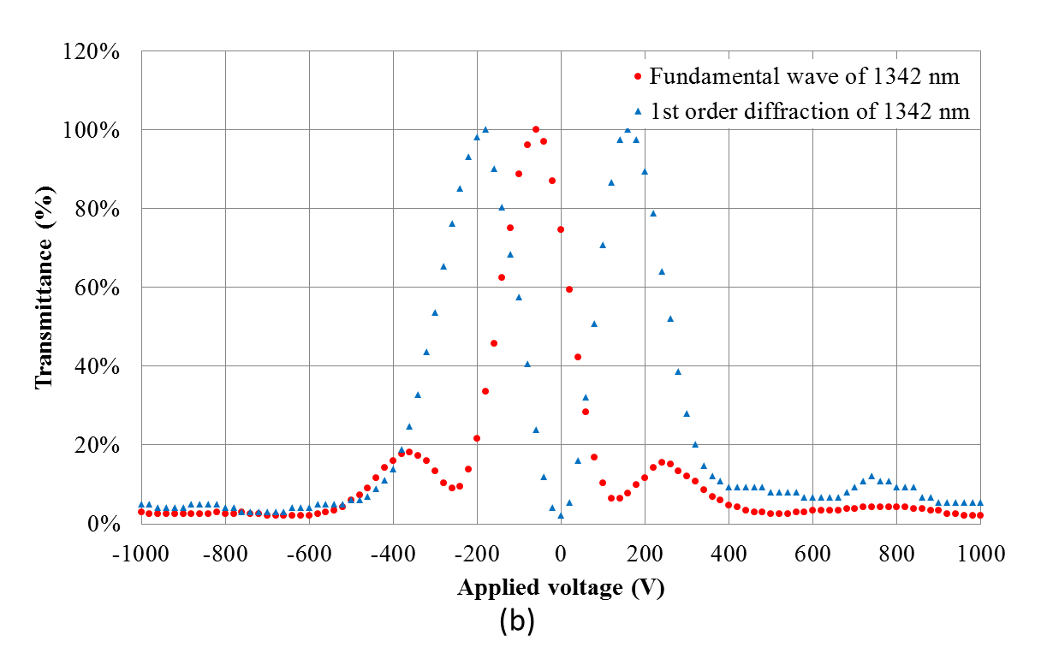
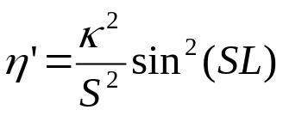

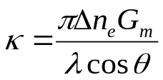

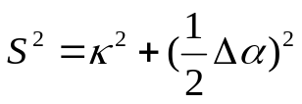

Diffraction efficiency measurements
High voltage
Low voltage
，
is Fourier coefficient
；
National Central University Department of Optical and Photonics
Nonlinear Integrated Laser Photonics Laboratory
NILP

Slide 27
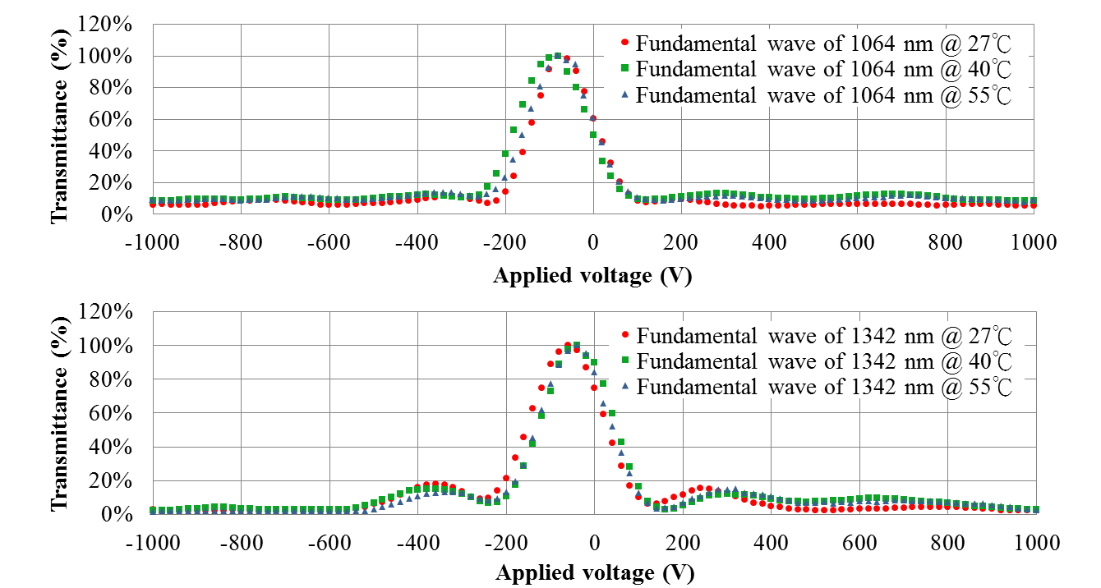
Diffraction efficiency measurements
National Central University Department of Optical and Photonics
Nonlinear Integrated Laser Photonics Laboratory
NILP

Slide 28
Scheme of the pulsed yellow orange laser
National Central University Department of Optical and Photonics
Nonlinear Integrated Laser Photonics Laboratory
NILP

Slide 29
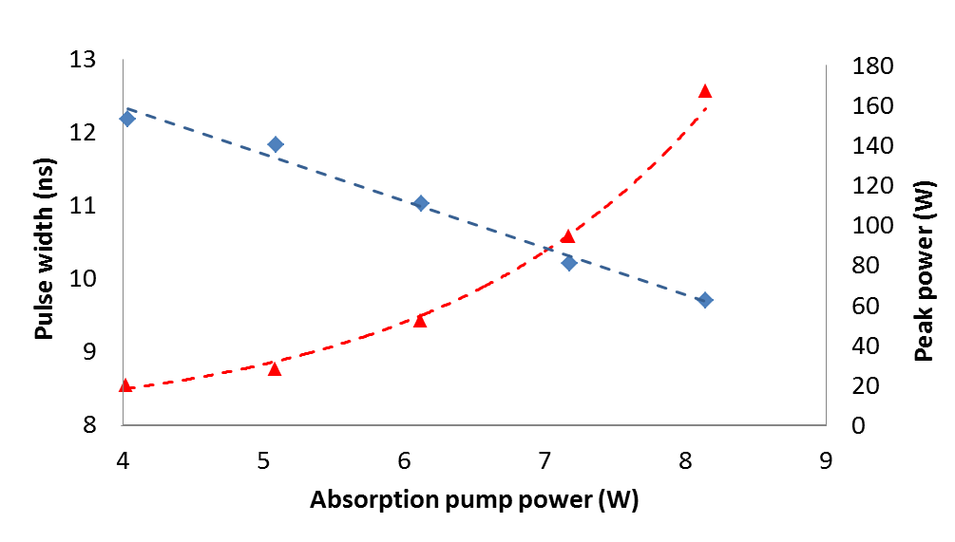
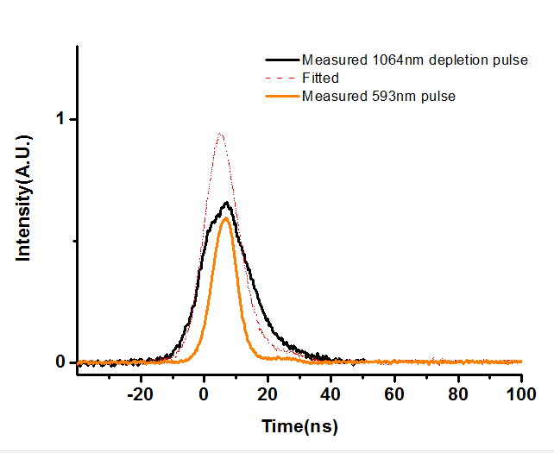
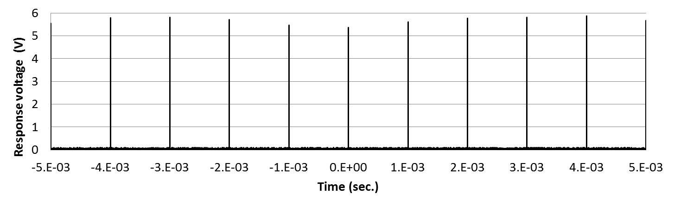
Pulsed yellow orange laser output performance
Fluctuation ~ 8.5%
National Central University Department of Optical and Photonics
Nonlinear Integrated Laser Photonics Laboratory
NILP

Slide 30
CONCLUSION
NILP
National Central University Department of Optical and Photonics
Nonlinear Integrated Laser Photonics Laboratory
NILP

Slide 31
Conclusion
We achieved in a collinear three-mirror dual-wavelength (1064 and 1342 nm) Nd:YVO₄ laser using a 4-cm long monolithic APPLN EO Bragg Q-switch working simultaneously at the two laser lines for efficient pulsed intracavity sum-frequency generation.
The monolithic APPLN EO Bragg deflector, designed by the AOS technique optimized by the SA method, can work simultaneously at the 1064 and 1342 nm laser lines with similar diffraction efficiency of >90% under the same Bragg angle (~1.4º) and driving voltage (~200 V).
The relatively rich reciprocal vectors in the aperiodic domain structure has enhanced the diffraction loss of the APPLN EO Bragg device at a high driving voltage.
When driving the APPLN EO Bragg Q-switch with 100 V pulses at 1 kHz, we obtained 593.5-nm orange light from the ISFG system with a peak power of > 167 W, at 8.5 W diode pump power.
National Central University Department of Optical and Photonics
Nonlinear Integrated Laser Photonics Laboratory
NILP

Slide 32

Future work
National Central University Department of Optical and Photonics
Nonlinear Integrated Laser Photonics Laboratory
NILP

Slide 33
ACKNOWLEDGE
NILP
國立中央大學 李正中老師 實驗室
國立中央大學 鍾德元老師 實驗室
國立清華大學 黃衍介老師 實驗室
National Central University Department of Optical and Photonics
Nonlinear Integrated Laser Photonics Laboratory
NILP

Slide 34
THANKS FOR YOUR ATTENTION!
NILP
National Central University Department of Optical and Photonics
Nonlinear Integrated Laser Photonics Laboratory
NILP

Slide 35

~ 99 %
Design parameters
  Beam diameter : 300 μm
  Unit block length : 4 μm
  Chip length : 40 mm
  Incident angle : 1.471°
  Applied voltage : 300 V
η_{1064 nm} = 99.65%
η_{1342 nm} = 99.27%
Fourier coefficient
Spatial frequency (μm⁻¹)
National Central University Department of Optical and Photonics
Nonlinear Integrated Laser Photonics Laboratory
NILP

